Slide 1
Welcome! (動) 歡迎, 接待 желанный Bienvenue
To the Economics, Test #4, Supply online review.
Click here to continue

Slide 2
Supply Online Review
Go through this review, answers the questions to the best of your ability
Click here to continue

Slide 3
Questions #1
Supply is based on a voluntary exchange by which of the following?
The government
entrepreneurs

Slide 4
Wrong answer
Click here to try again

Slide 5
Correct Answer
Click here to go to the next question

Slide 6
Questions #2
A supply curve is a graph that shows the various quantities supplied at a single market price
TRUE
FALSE

Slide 7
Correct Answer
Click here to go to the next question

Slide 8
Questions #3
A subsidy is a government ____________ to encourage or protect an economic activity
payment
loan
transfer

Slide 9
Correct Answer
Click here to go to the next question

Slide 10
Questions #4
What will suppliers do if they think the price of their product is going up in the future?
Sell as much as the can now
Withhold supply for later on
Do nothing and ride out the price increase

Slide 11
Correct Answer
Click here to go to the next question

Slide 12
Questions #5
Supply elasticity is a measure in which quantity supplied responds to a change in _________
demand
quantity demanded
subsidies
price

Slide 13
Correct Answer
Click here to go to the next question

Slide 14
Questions #6
If a product is said to be elastic, then price and output move in the?
Same direction
Opposite directions

Slide 15
Correct Answer
Click here to go to the next question

Slide 16
Questions #7
If a company can adjust quickly to new or changes in prices, the production is said to be?
inelastic
elastic

Slide 17
Correct Answer
Click here to go to the next question

Slide 18
Questions #8
Substitute products have a huge effect on supply elasticity
TRUE
FALSE

Slide 19
Correct Answer
Click here to go to the next question

Slide 20
Questions #9
Which is NOT an effect of total production rising?
More workers are added
Production grows, but slowly
Plant output rises
Workers can specialize

Slide 21
Correct Answer
Click here to go to the next question

Slide 22
Questions #10
The focus of the Thoery of Production is on what?
FoP
Variable costs
Fixed costs
Changes in labor

Slide 23
Correct Answer
Click here to go to the next question

Slide 24
Questions #11
In the long run, the only FoP that can be changed is labor.
TRUE
FALSE

Slide 25
Correct Answer
Click here to go to the next question

Slide 26
Questions #12
The Law of Variable Proportions mainly takes into account?
Long run
Short run

Slide 27
Correct Answer
Click here to go to the next question

Slide 28
Questions #13
Only changes in ________ lead to change in supply elasticity.
consumption
substitutes
production
compliments

Slide 29
Correct Answer
Click here to go to the next question

Slide 30
Questions #14
Law of Supply tells us that producers will supply more of a product at _________ prices.
higher
lower

Slide 31
Correct Answer
Click here to go to the next question

Slide 32
Questions #15
A change in the quantity supplied is response to what?
demand
price
subsidies
anything else

Slide 33
Correct Answer
Click here to go to the next question

Slide 34
Questions #16
A change is supply is a response to which?
demand
price
subsidies
anything else

Slide 35
Correct Answer
Click here to go to the next question

Slide 36
Questions #17
The Theory of Production looks at the relationship between?
FoP & input
Substitute goods & output
FoP & output
Complimentary goods & input

Slide 37
Correct Answer
Click here to go to the next question

Slide 38
Questions #18
If total production slows, out still ___________, but at a ___________ rate.
Rises / quicker
Decrease / quicker
Decreases / slower
Rises / slower

Slide 39
Correct Answer
Click here to go to the next question

Slide 40
Questions #19
Which is NOT one of the three stages of production?
Marginal Returns
Increasing Returns
Diminishing Returns
Negative Returns

Slide 41
Correct Answer
Click here to go to the next question

Slide 42
Questions #20
An expense you pay no matter if the company produces or not is called?
Variable costs
Total costs
Fixed costs
Marginal costs

Slide 43
Correct Answer
Click here to go to the next question

Slide 44
Questions #21
The Supply curve shows all various quantities supplied at all market prices?
TRUE
FALSE

Slide 45
Correct Answer
Click here to go to the next question

Slide 46
Questions #22
Productivity will increase if workers are happy and motivated.
TRUE
FALSE

Slide 47
Correct Answer
Click here to go to the next question

Slide 48
Questions #23
If producers expect higher prices in the future, they will supply more now
TRUE
FALSE

Slide 49
Correct Answer
Click here to go to the next question

Slide 50
Questions #24
The Theory of Production mainly focuses on labor in the short term
TRUE
FALSE

Slide 51
Correct Answer
Click here to go to the next question

Slide 52
Questions #25
Law of Variable Proportions focuses mainly on changing only labor.
TRUE
FALSE

Slide 53
Correct Answer
Click here to go to the next question

Slide 54
Questions #26
The supply of a product will increase if …?
Cost of inputs increases
Taxes on the product decrease
More producers leave the market
Price o/t product decreases

Slide 55
Correct Answer
Click here to go to the next question

Slide 56
Questions #27
Which industry gets the most subsidies?
teaching
construction
agriculture
manufacturing

Slide 57
Correct Answer
Click here to go to the next question

Slide 58
Questions #28
If total production rises, which is NOT an outcome of this production increase?
More workers are added
Workers specialize
Plant output rises
Raw materials decrease in costs

Slide 59
Correct Answer
Click here to go to the next question

Slide 60
Congratulations!
If you answered the majority of the questions correctly, you will do well on the test.
Click to go to the next slide!

Slide 61
The test will be made up of:
~13 True / False Questions
~15 Multiple Choice Questions
~4 questions over fixed, variable, total costs
~4 questions over diminishing returns, where to hire graph, etc
5 matching questions
Graph problem
Headlines problem
Click to go to the next slide!

Slide 62
More Info
Make sure to bring a pencil, study, and get a good night’s sleep.
Click here to see pictures of Mr. Campbell’s new dogs!
Click here to re-take the review

Slide 63
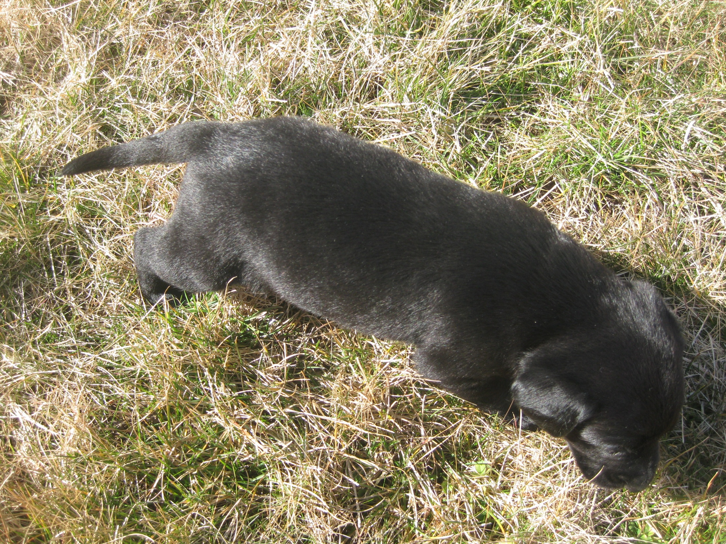

Slide 67
